Slide 1
Data visualization and Presentation of findings
Po-Chih Kuo
Human-centered machine Intelligence Lab
Department of Computer Science
National Tsing Hua University

Slide 2
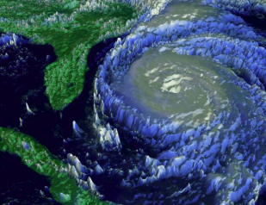
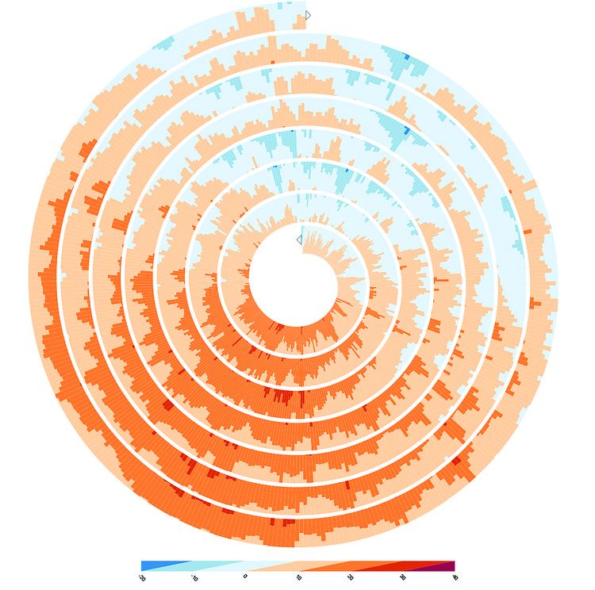
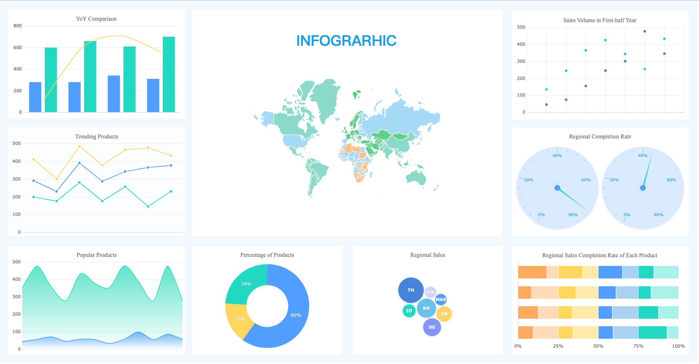
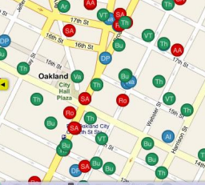
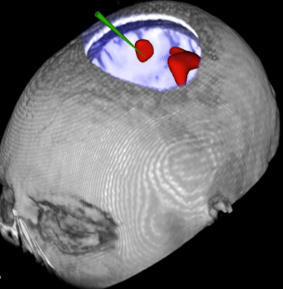

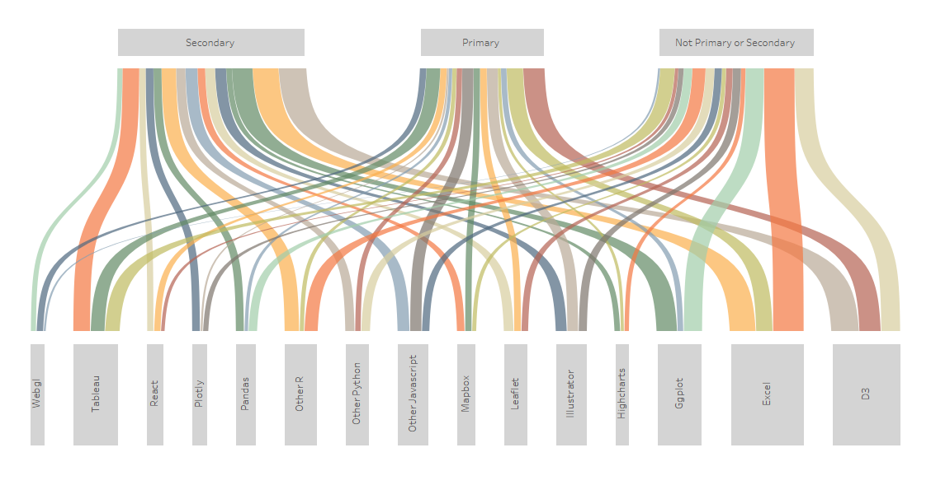
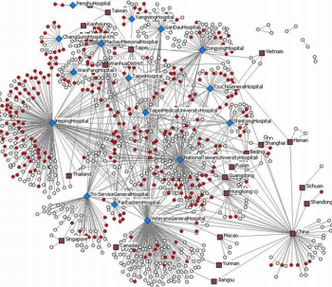
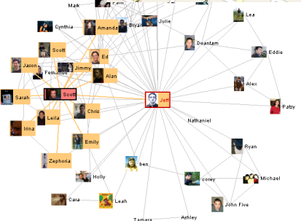
What is Data Visualization?
Visual representation of data
For exploration, discovery, insight, ..

Slide 3
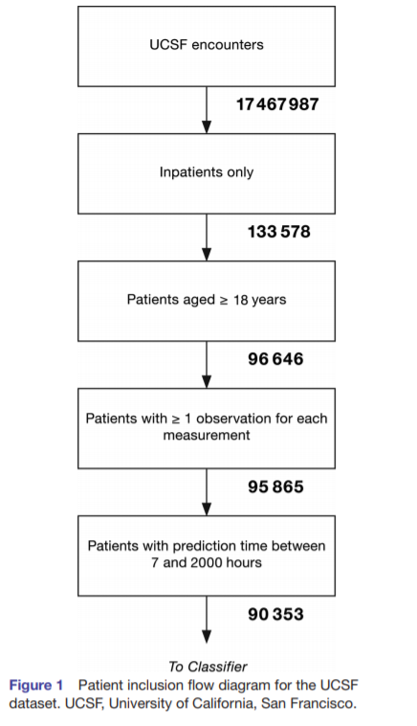
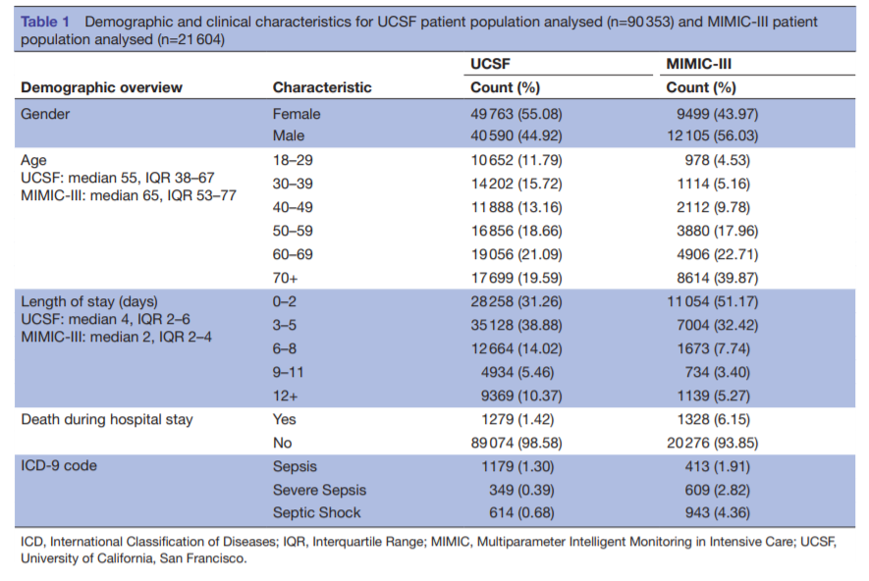
Table 1 and Figure 1
Mao, Qingqing, et al. "Multicentre validation of a sepsis prediction algorithm using only vital sign data in the emergency department, general ward and ICU." BMJ open 8.1 (2018).

Slide 4
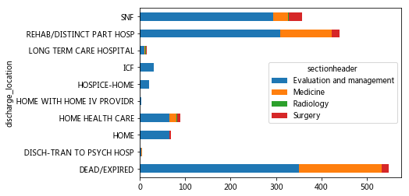
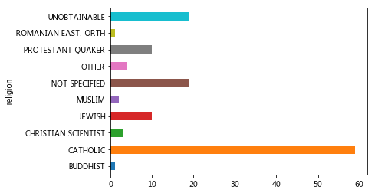
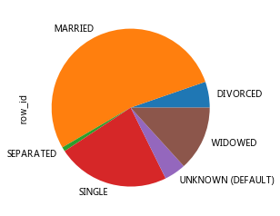
Chart

Slide 5
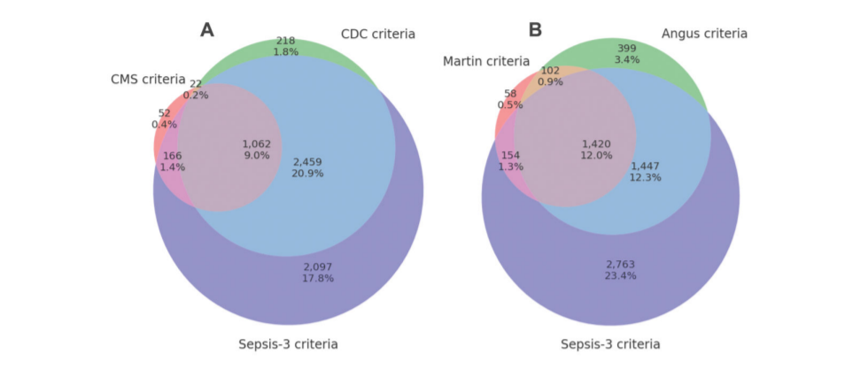
Data Extraction Criteria
Johnson, Alistair EW, et al. "A comparative analysis of sepsis identification methods in an electronic database." Critical care medicine 46.4 (2018): 494.

Slide 6
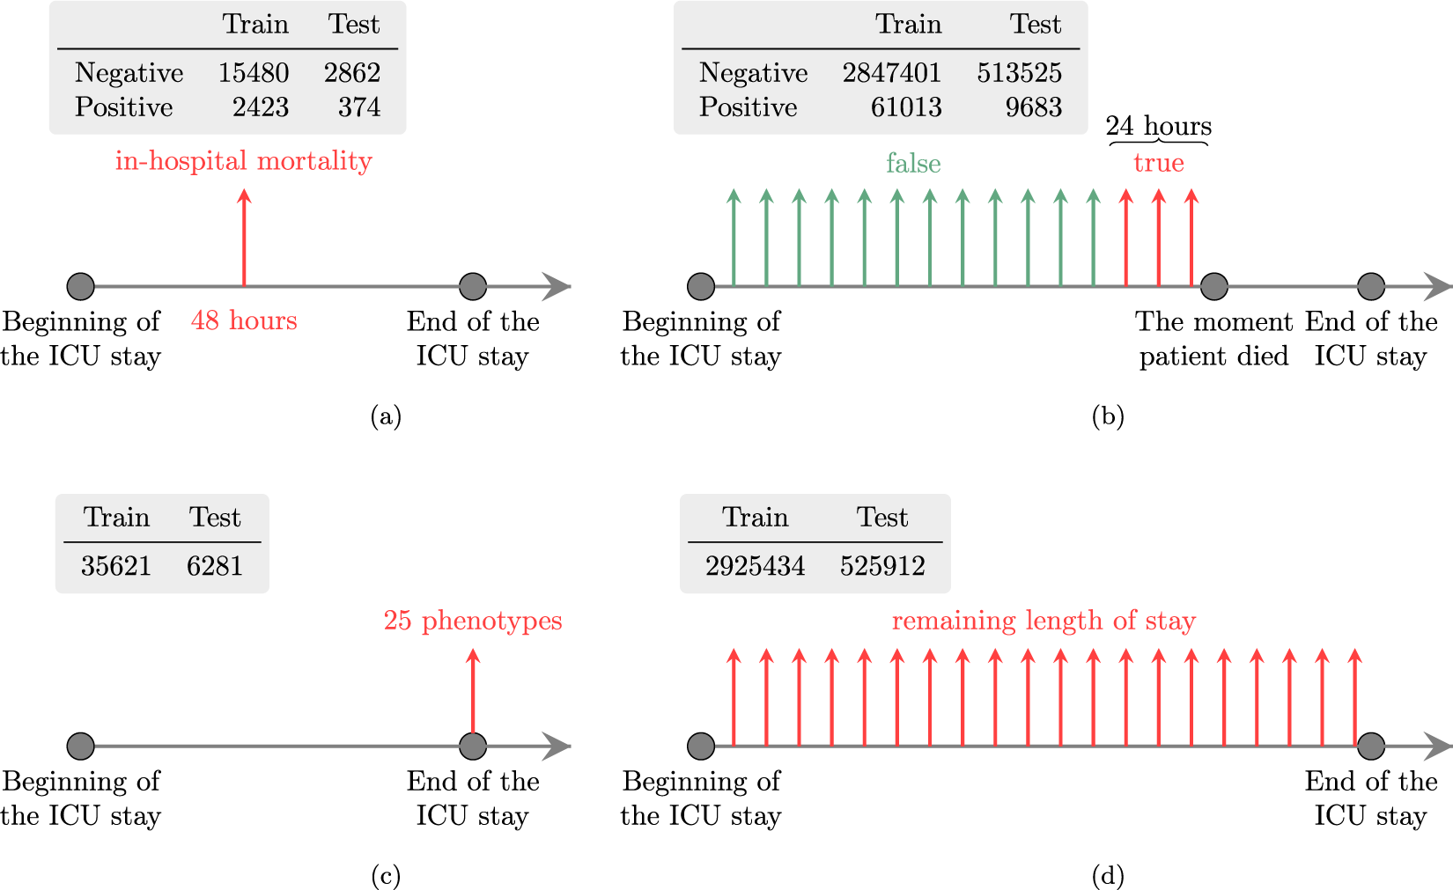
Harutyunyan, Hrayr, et al. "Multitask learning and benchmarking with clinical time series data." Scientific data 6.1 (2019): 1-18.

Slide 7
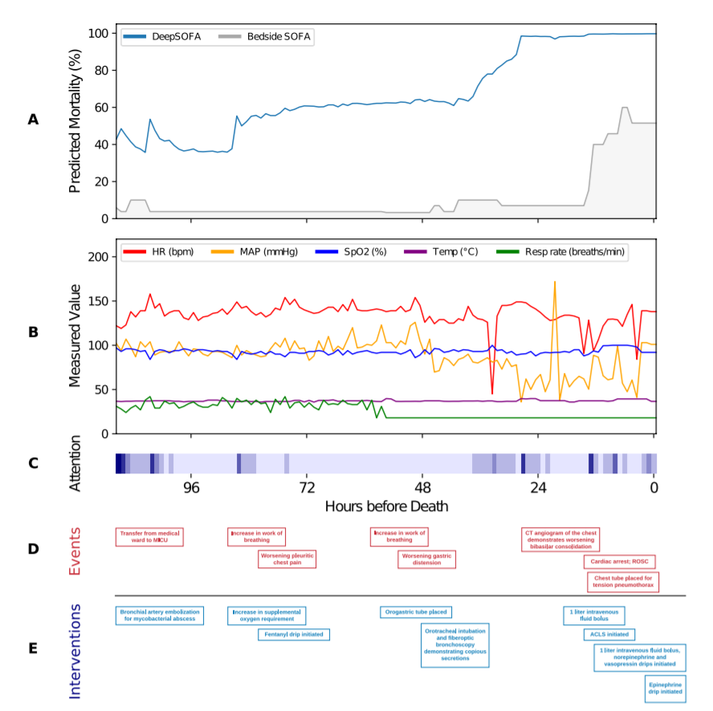
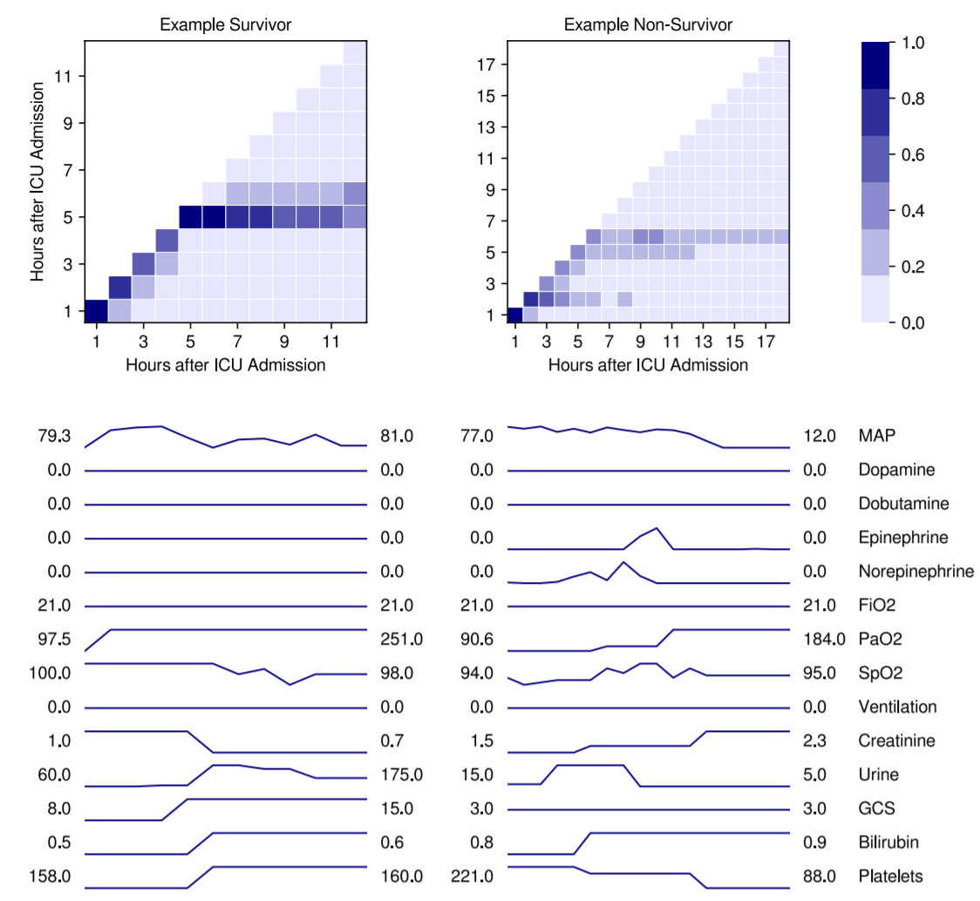
Data from single patient
Shickel, Benjamin, et al. "DeepSOFA: a continuous acuity score for critically ill patients using clinically interpretable deep learning." Scientific reports 9.1 (2019): 1-12.

Slide 8
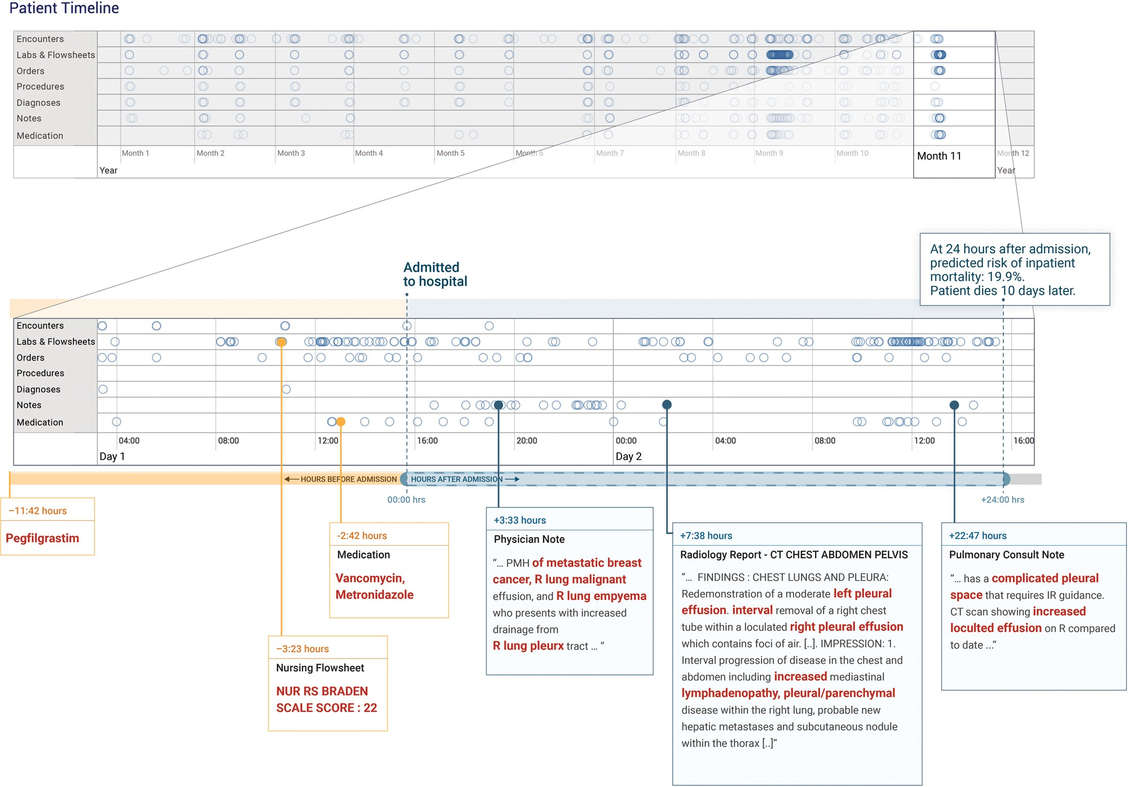
Rajkomar, Alvin, et al. "Scalable and accurate deep learning with electronic health records." NPJ Digital Medicine 1.1 (2018): 18.

Slide 9
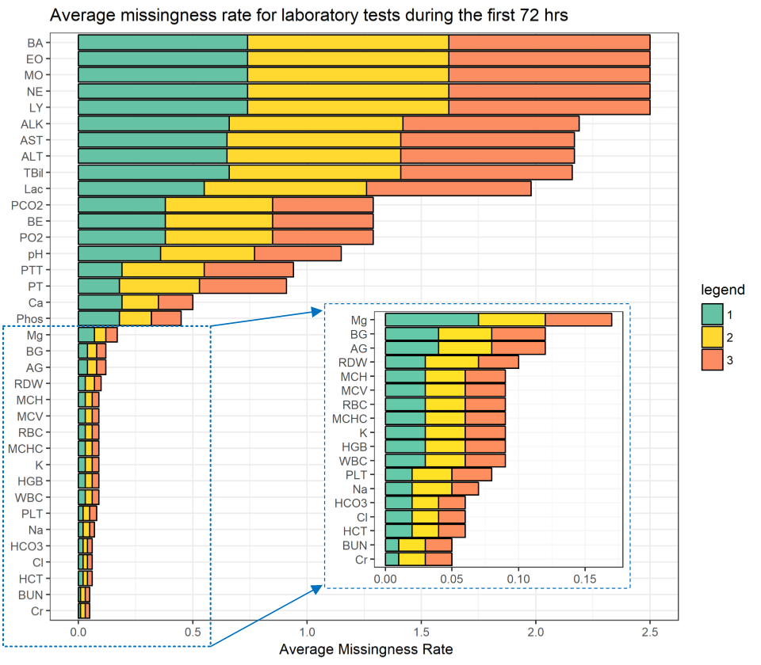
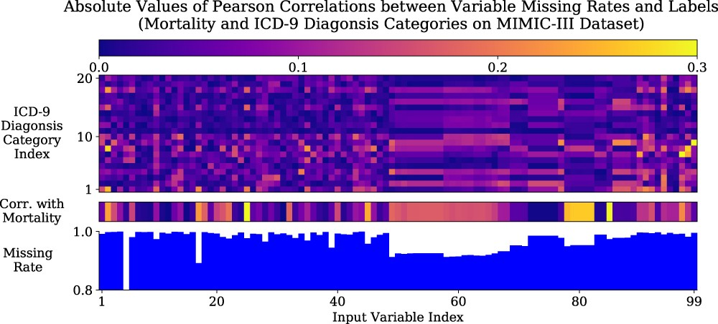
Missing data
Che, Zhengping, et al. "Recurrent neural networks for multivariate time series with missing values." Scientific reports 8.1 (2018): 1-12.
Sharafoddini, Anis, et al. "A new insight into missing data in intensive care unit patient profiles: Observational study." JMIR medical informatics 7.1 (2019): e11605.

Slide 10
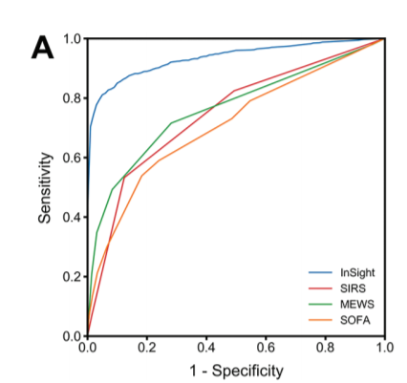
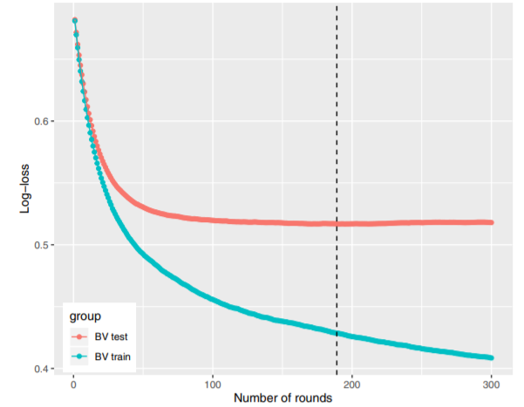
MODEL Performance

Slide 11
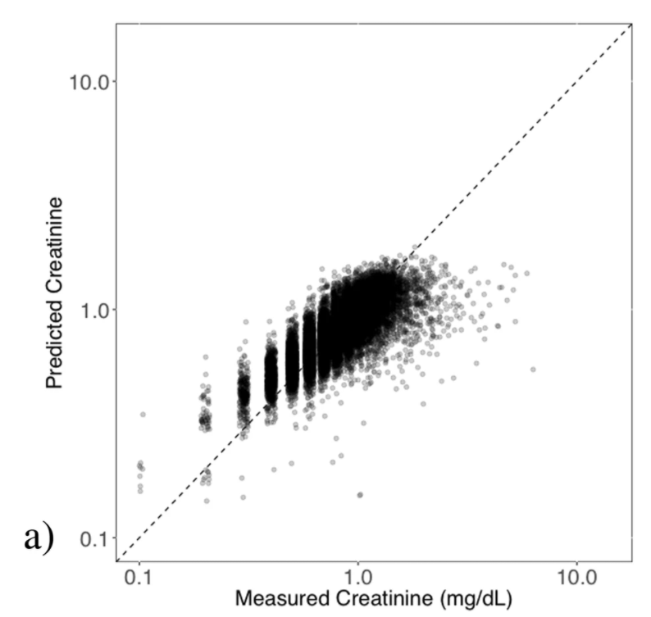
Regression: Correlation
Zimmerman, Lindsay P., et al. "Early prediction of acute kidney injury following ICU admission using a multivariate panel of physiological measurements." BMC medical informatics and decision making 19.1 (2019): 1-12.

Slide 12
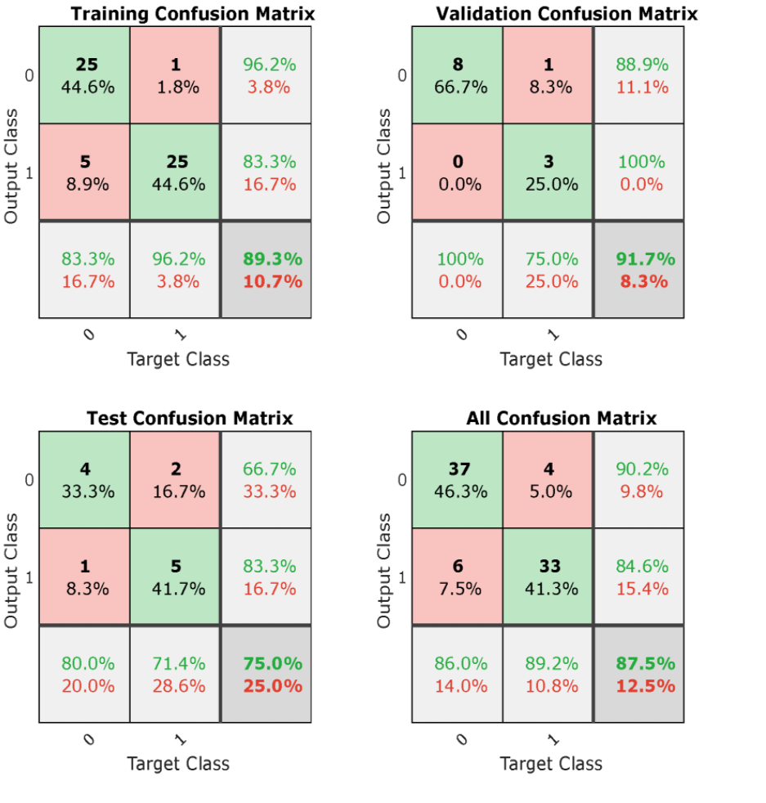
Classification: Confusion matrix
Martínez, Gloria, et al. "Can photoplethysmography replace arterial blood pressure in the assessment of blood pressure?." Journal of clinical medicine 7.10 (2018): 316.

Slide 13
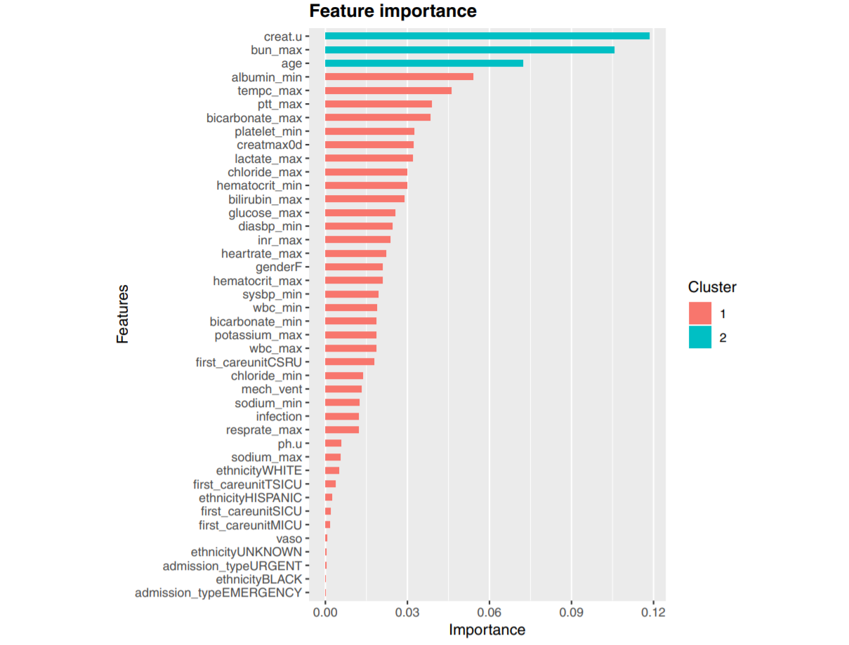
Feature importance
Zhang, Zhongheng, Kwok M. Ho, and Yucai Hong. "Machine learning for the prediction of volume responsiveness in patients with oliguric acute kidney injury in critical care." Critical Care 23.1 (2019): 112.

Slide 14
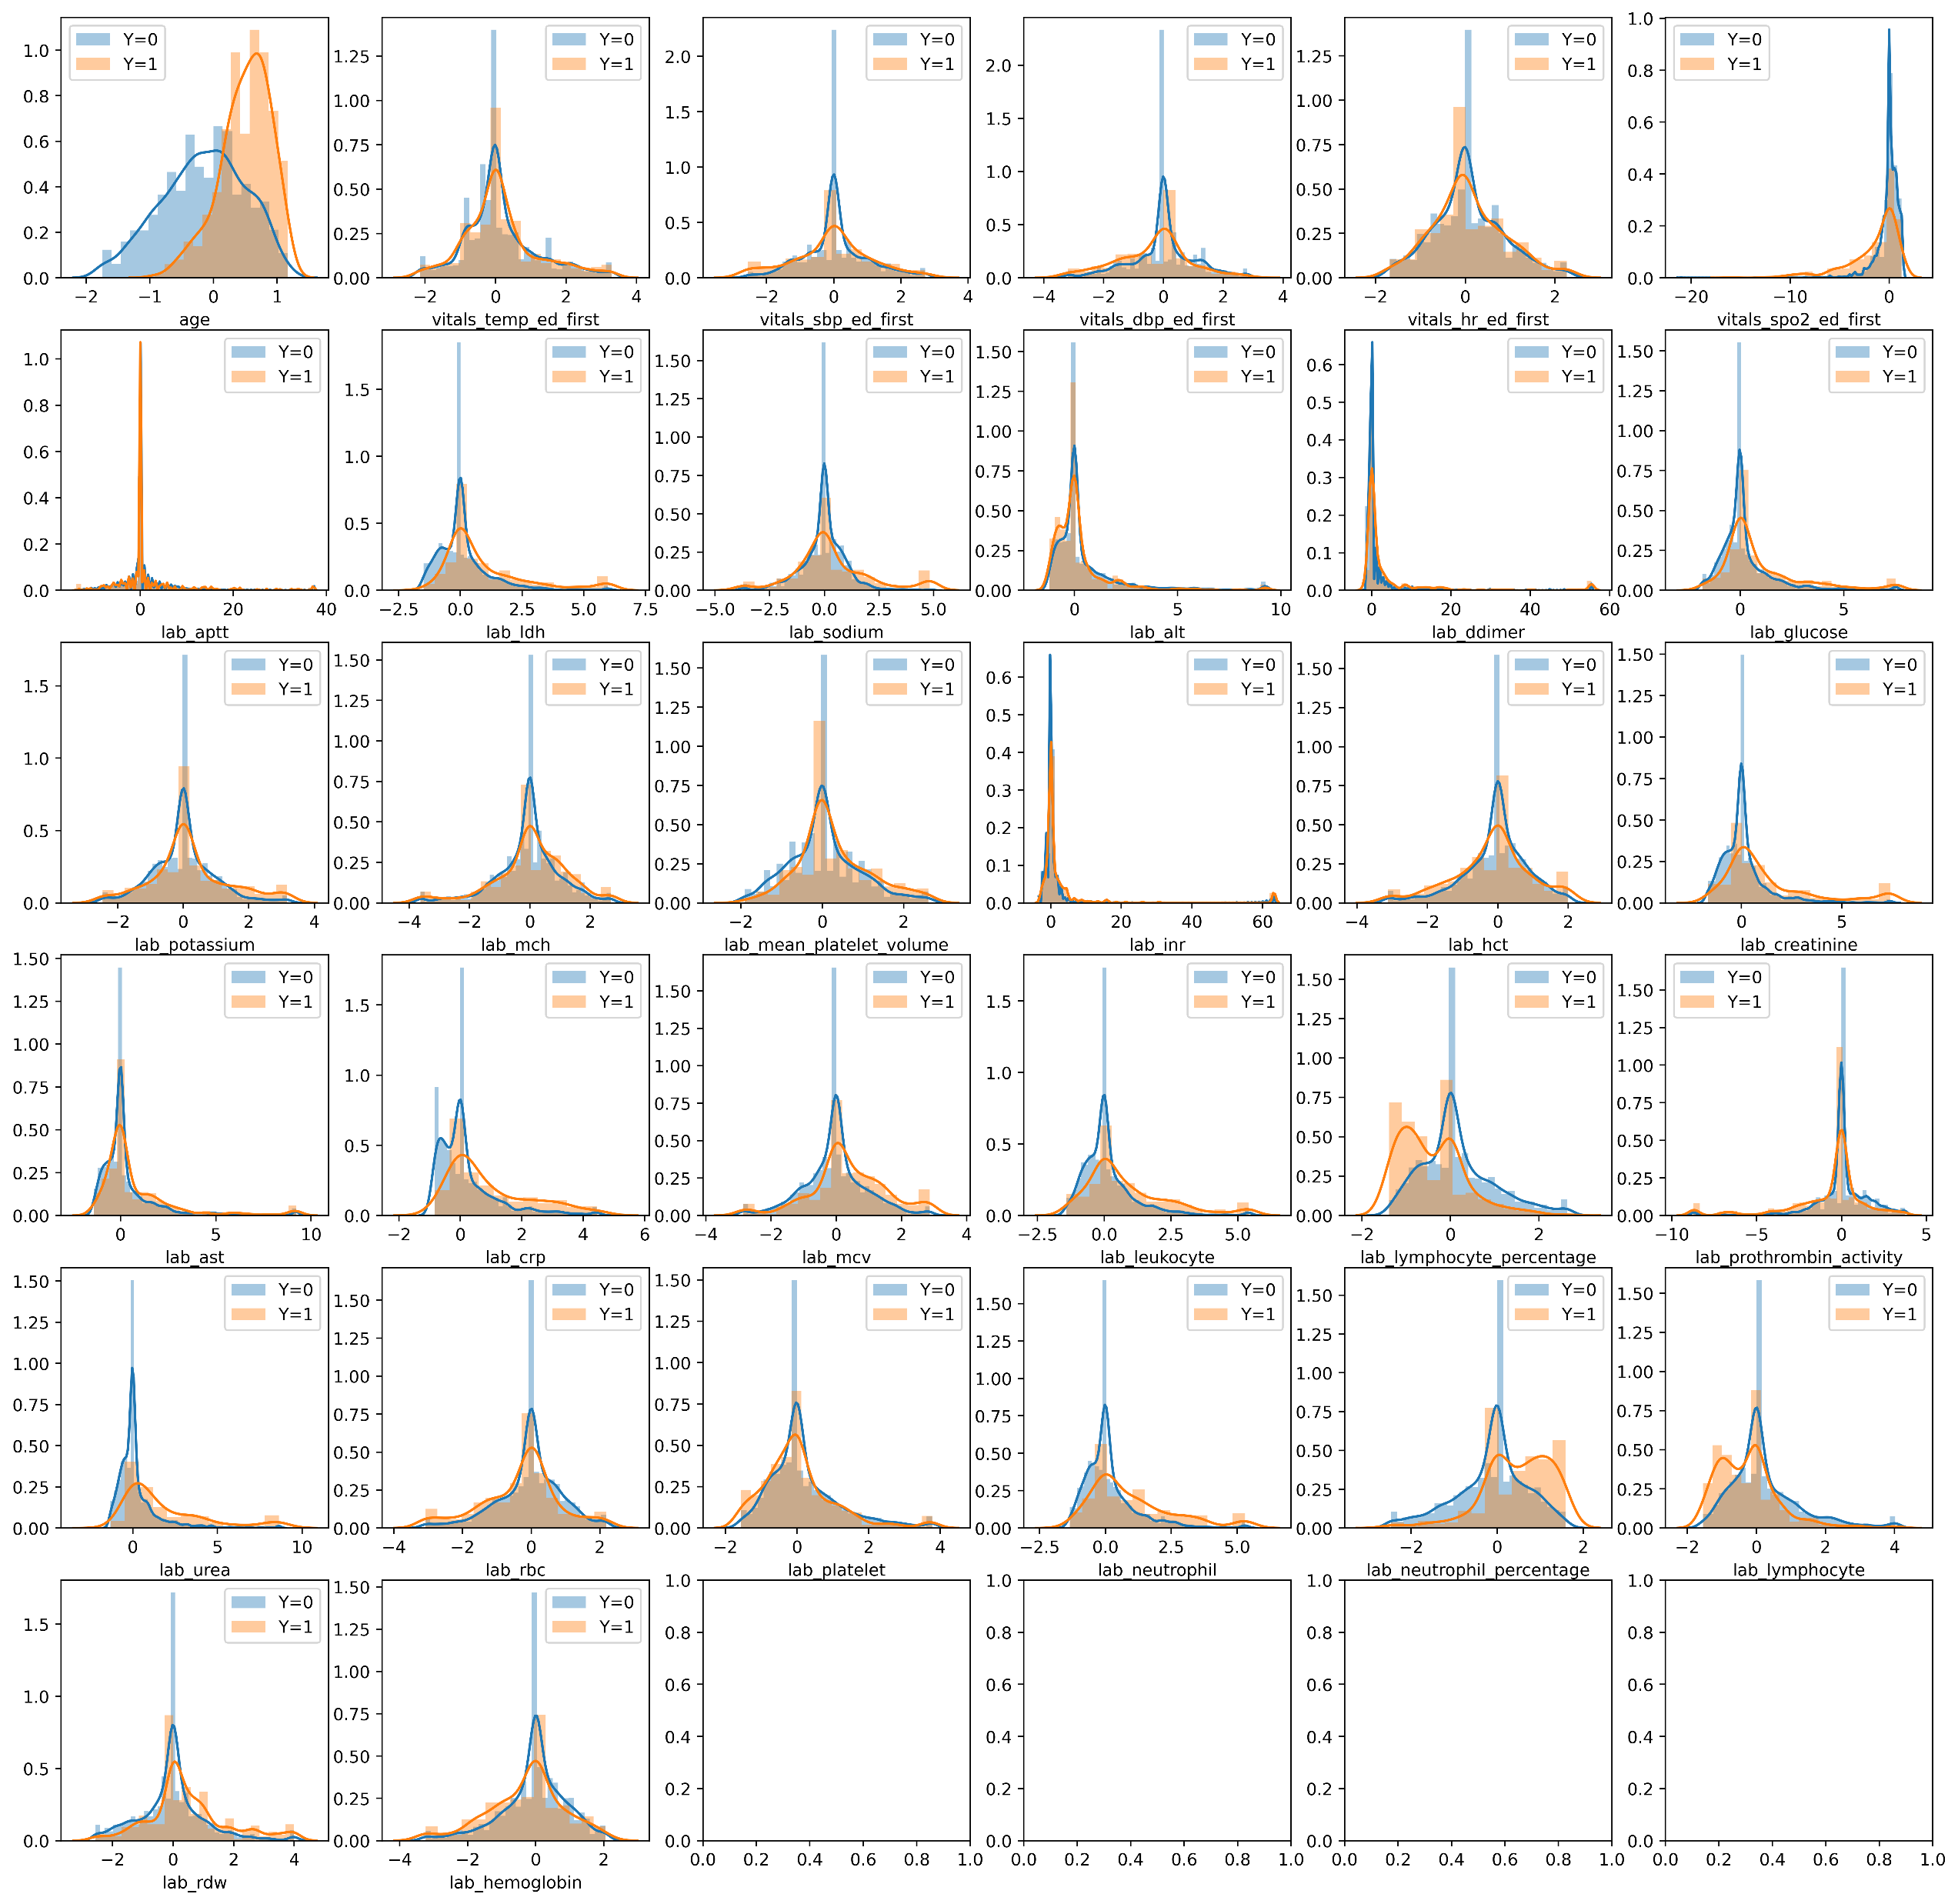
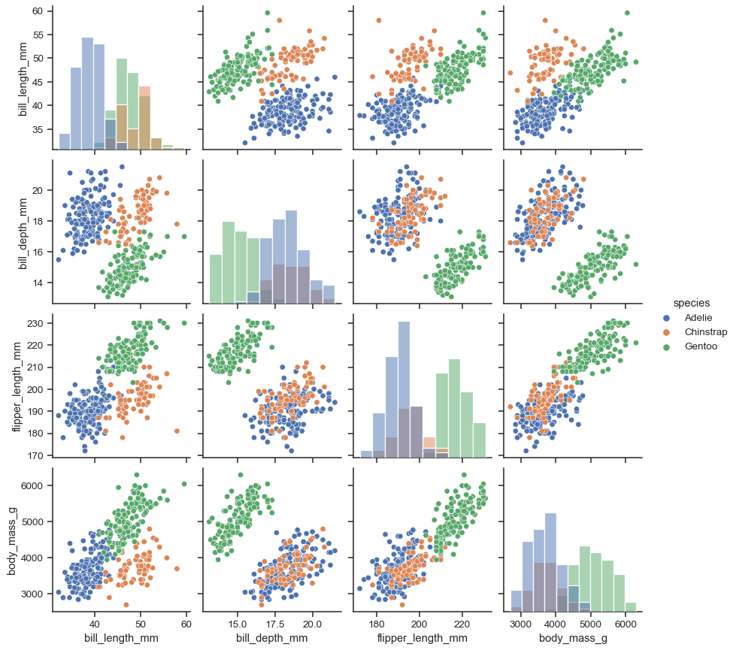
Feature Visualization

Slide 15
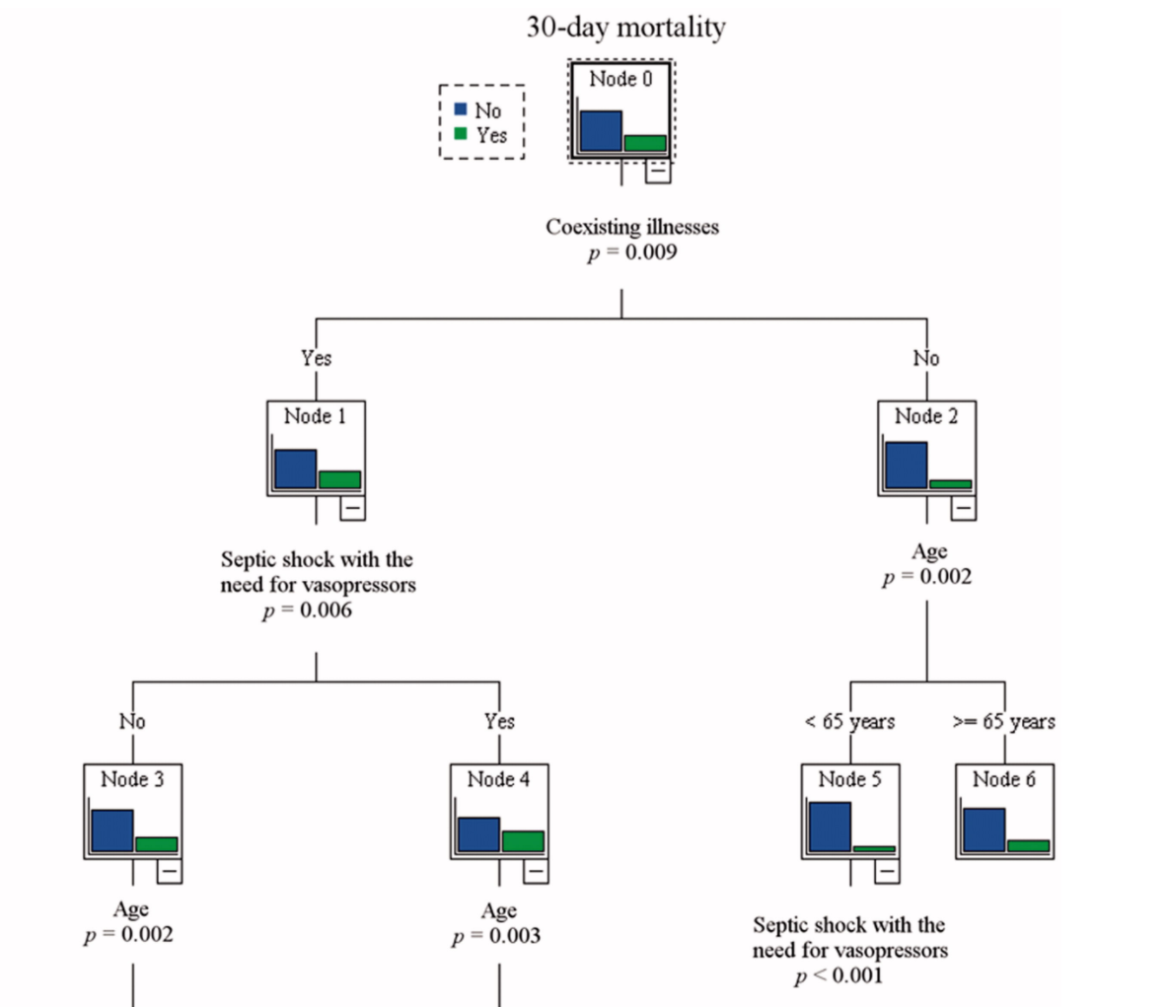
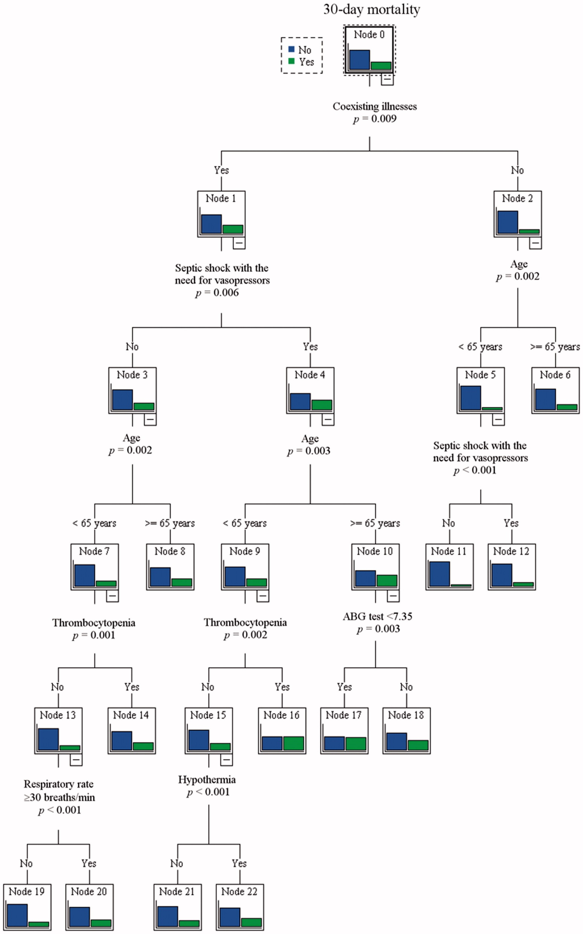
Decision Trees

Slide 16
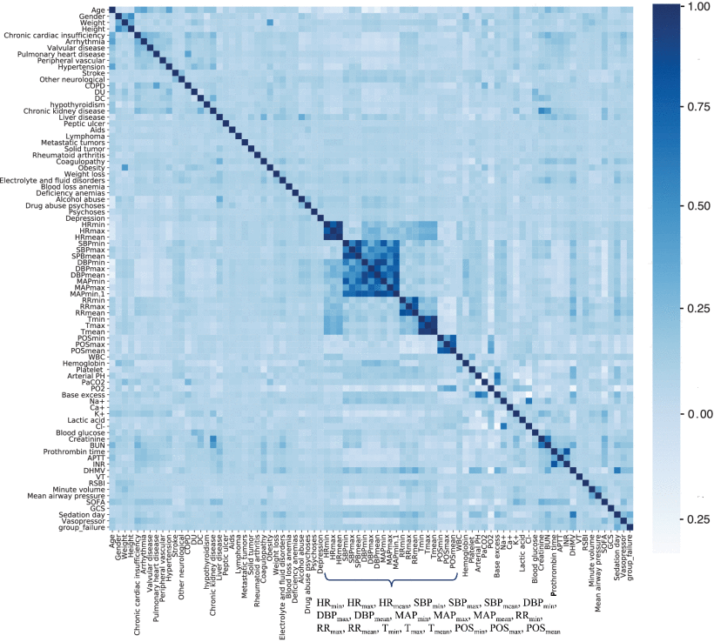
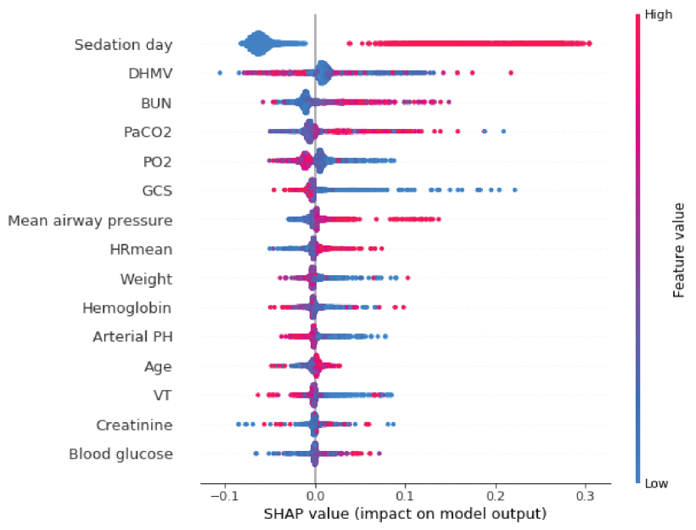
Feature correlation & SHAP
SHAP (SHapley Additive exPlanations) can explain the output of any machine learning model.
Chen, Tingting, et al. "Prediction of Extubation Failure for Intensive Care Unit Patients Using Light Gradient Boosting Machine." IEEE Access 7 (2019): 150960-150968.

Slide 17

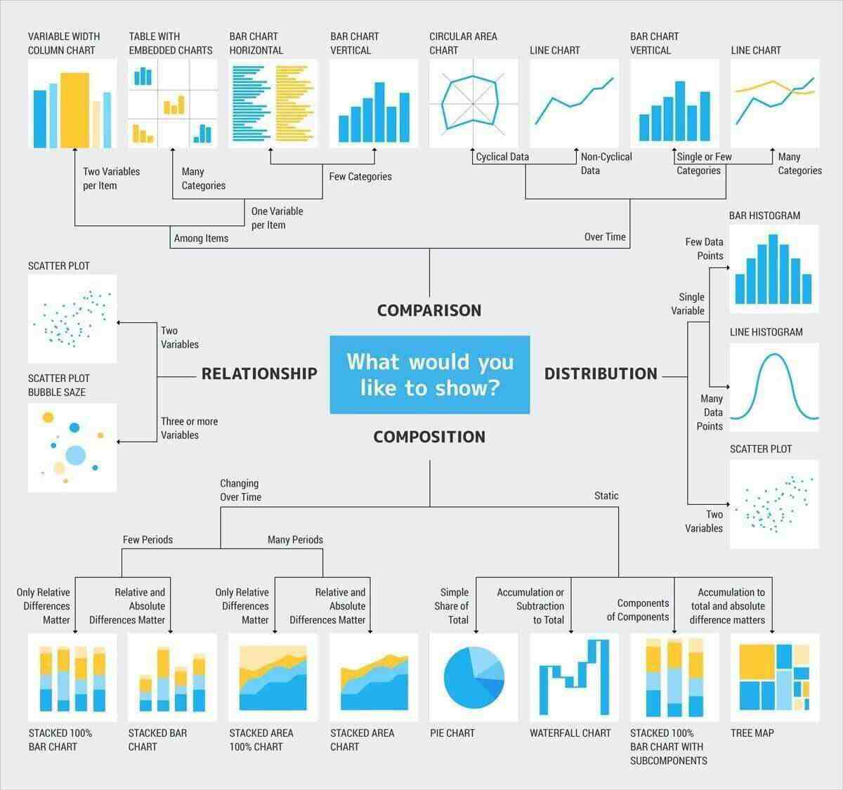

Slide 18


DEMO
https://github.com/MIT-LCP/mimic-code/blob/master/tutorials/data_viz/01_data_viz_basic.ipynb
Tableone (https://pypi.org/project/tableone/)
Pandas
Pandas-Profiling
Missingno
Wordcloud

